Slide 1
QUERY PROCESSING: SORTING AND JOINS
SUBMITTED BY:
ZUBAIR KHAN 19PWCSE1797
ZAINAB KHALID 19PWCSE1743

Slide 2
Contents
Introduction to query processing
Sorting
Different sorting algorithms
Joins
Different types of joins
Conclusion

Slide 3
Query Processing
Translation of high-level queries into
low-level expressions.
Steps:
Parsing/Translation
Optimization
Evaluation

Slide 4
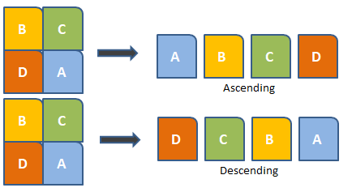
Sorting
Ordering data in an increasing or decreasing fashion according to some linear relationship among the data items.
2-way sort
Merge sort
External merge sort
Heap Sort
Quick Sort

Slide 5
2 way sort
sorts a data stream using repeated merges.
distributes the input into two streams by repeatedly reading a block of input
run, sorting it, then writing it to the next stream.
It then repeatedly distributes the runs in the output stream to the two streams and merges them until there is a single sorted output.

Slide 6
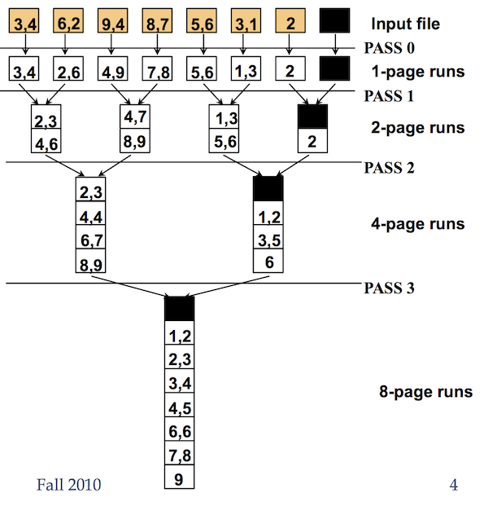
The total computing time:
0(n log₂n)
it needs two arrays of a similar size and space for the merge phase.
to sort a list of size n, it requires space for 2n elements.
Divide and Conquer algorithm

Slide 7
Internal Sort (Quick sort)
also called partition-exchange sort.
divides the list into three main parts:
Elements less than the Pivot element
Pivot element(Central element)
Elements greater than the pivot element

Slide 8
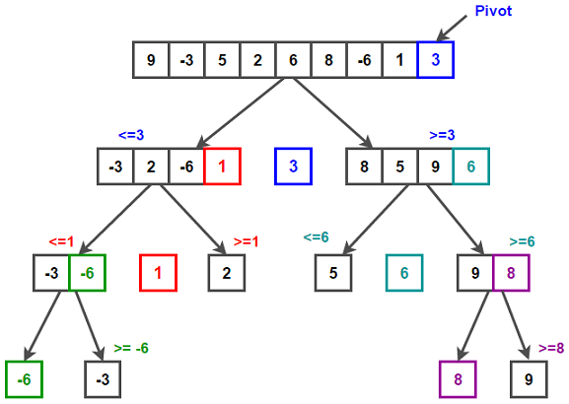
Worst Case Time Complexity
[ Big-O ]: O(n²)
Best Case Time Complexity [Big-omega]: O(n*log n)
Average Time Complexity [Big-theta]: O(n*log n)
Space Complexity: O(n*log n)

Slide 9
Heap Sort
Heapsort algorithm uses one of the tree concepts called Heap Tree.
use Max Heap to arrange list of elements in
Descending order and Min Heap to arrange list of
elements in Ascending order.
Best Case O(n log n)
Average Case O(n log n)
Worst Case O(n log n)
Tournament Sort

Slide 10
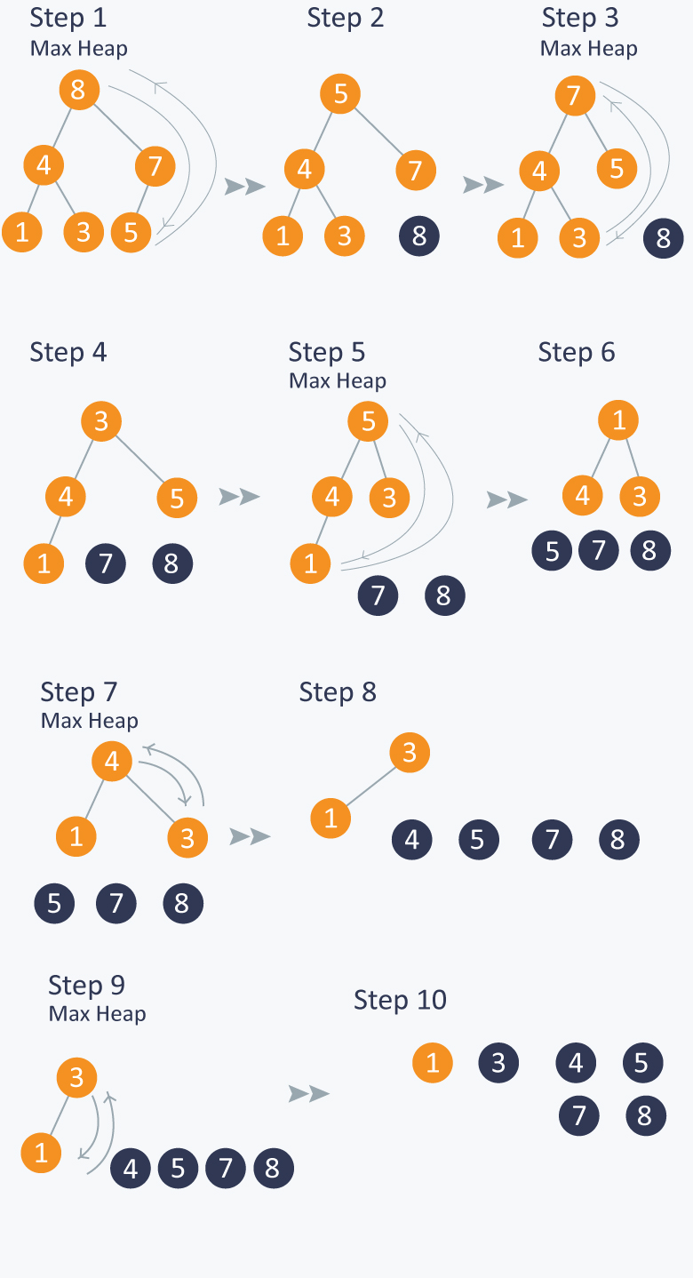

Slide 11
B+ trees for sorting
B+ Tree is an extension of B Tree which allows efficient insertion, deletion and search operations.
records (data) can only be stored on the leaf nodes while internal nodes can only store the key values.
Clustered B+ tree
Unclustered B+ tree

Slide 12
Advantages
Records can be fetched in equal number of disk accesses.
Height of the tree remains balanced and less as compare to B tree.
We can access the data stored in a B+ tree sequentially as well as directly.
Keys are used for indexing.
Faster search queries as the data is stored only on the leaf nodes.

Slide 13
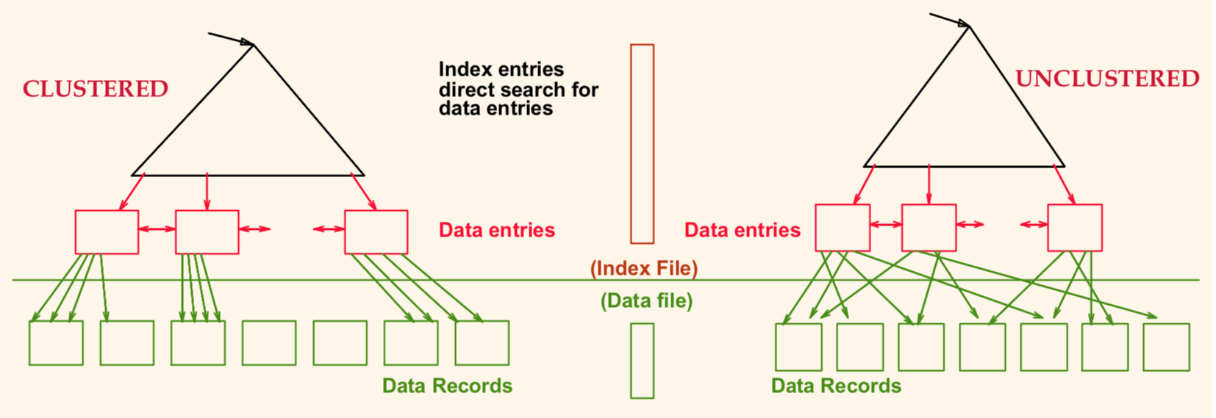

Slide 14
Joins
Used to combine rows from two or more tables, based on a related column between them.
Nested loop
Merge join
Hash join

Slide 15
Nested Loop Join
for each row of the outer table, each
row from the inner table is retrieved
and compared.
The nested loop technique is very slow if there is no index for the join column of the inner table.

Slide 16
Merge Join
The rows of the joined tables must
be physically sorted using the values
of the join column.
Both tables are then scanned in order of the join columns, matching the rows with the same value for the join columns.

Slide 17
Hash Join
used when there are no indices for join columns.
both tables that have to be joined are considered as two inputs: the build input and the probe input.
smaller table usually represents the build input

Slide 18
Conclusion
Sorting is an important technique in
the query processing
Data need to be in a specific order
Join tables for efficient data management
Use sorting and joins to run the queries fast

